Slide 1

PowerBi Dashboard
T-Series Channel Songs Data Analysis

Slide 2
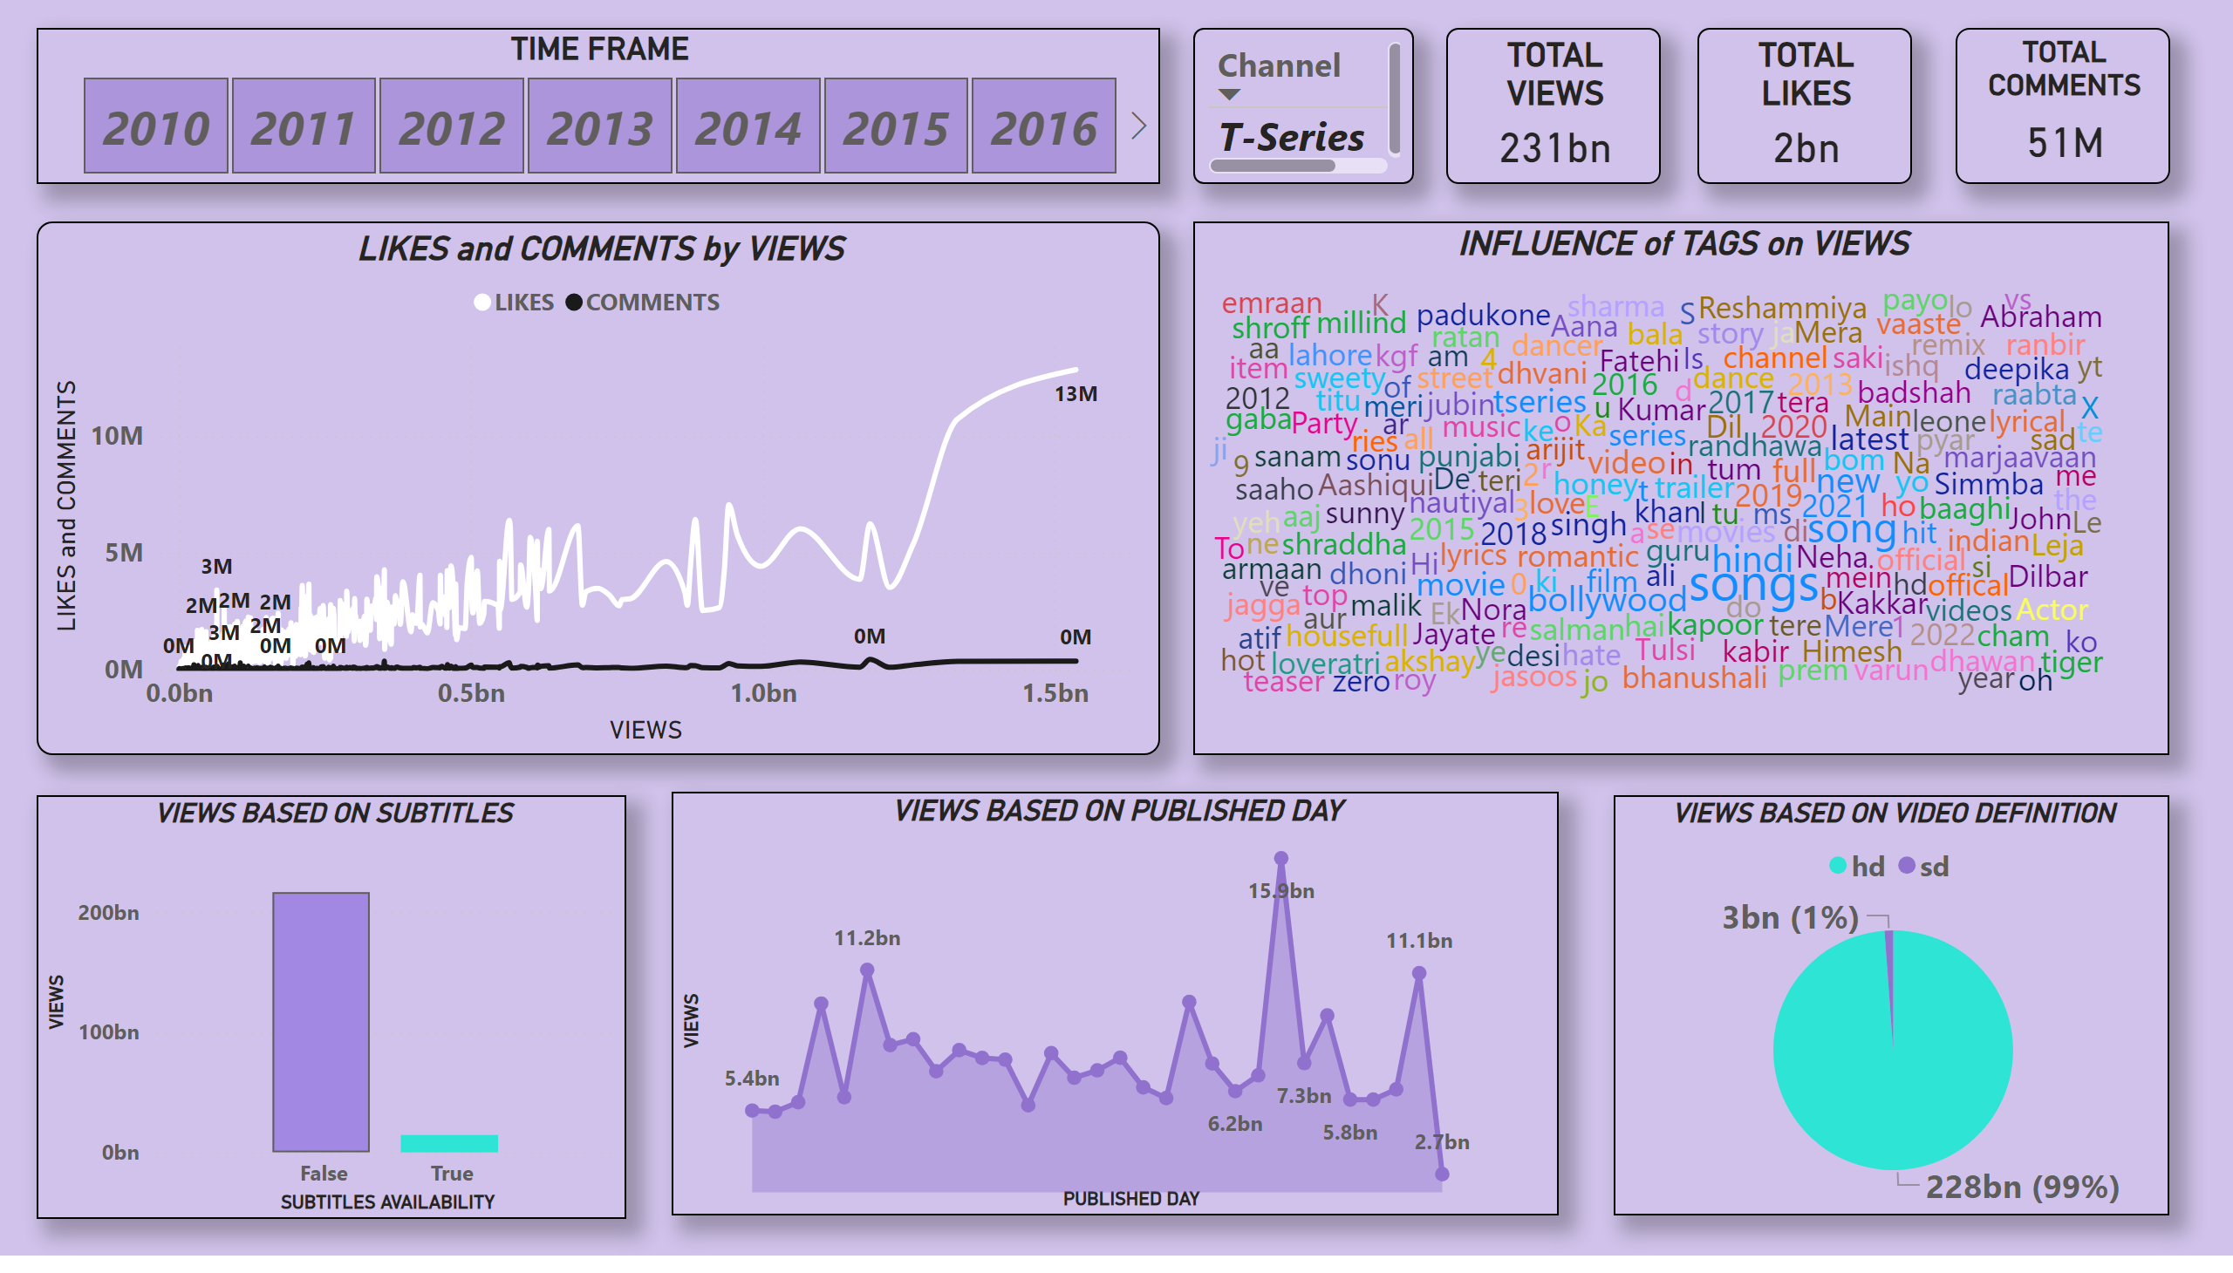
Page 1

Slide 3
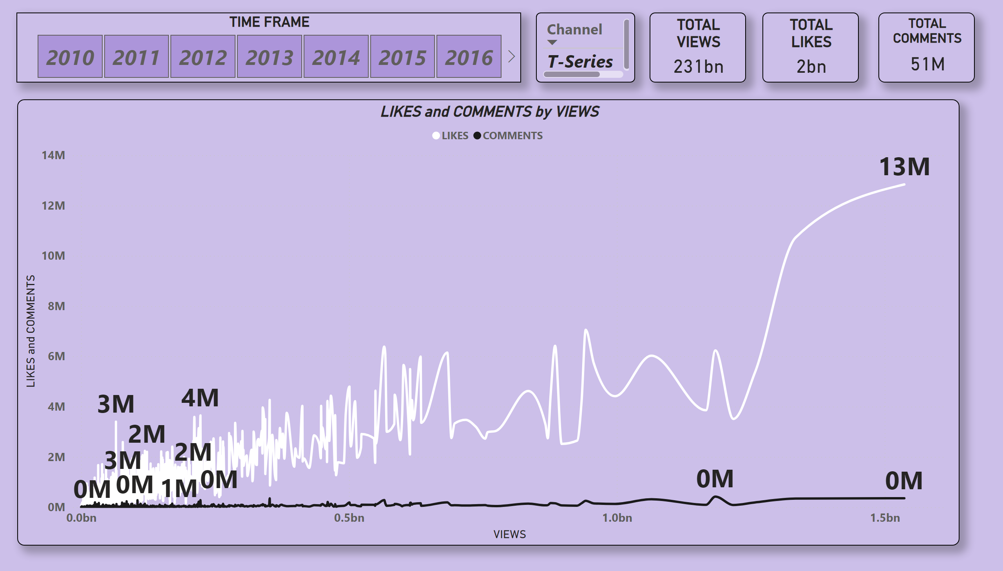
Page 2

Slide 4
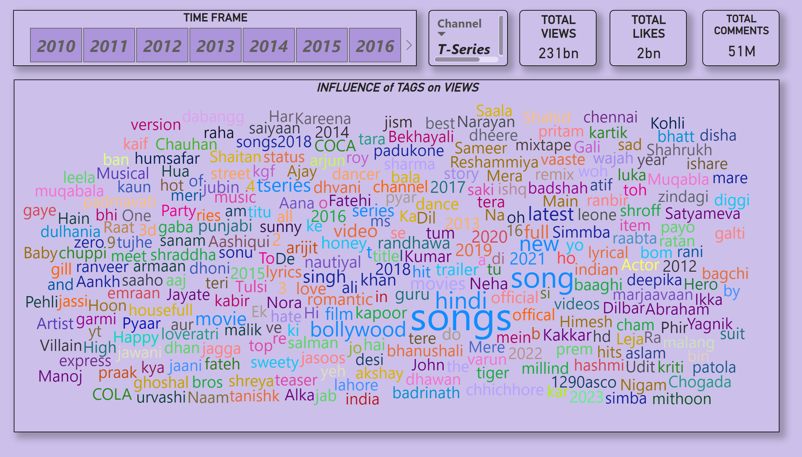
Page 3

Slide 5
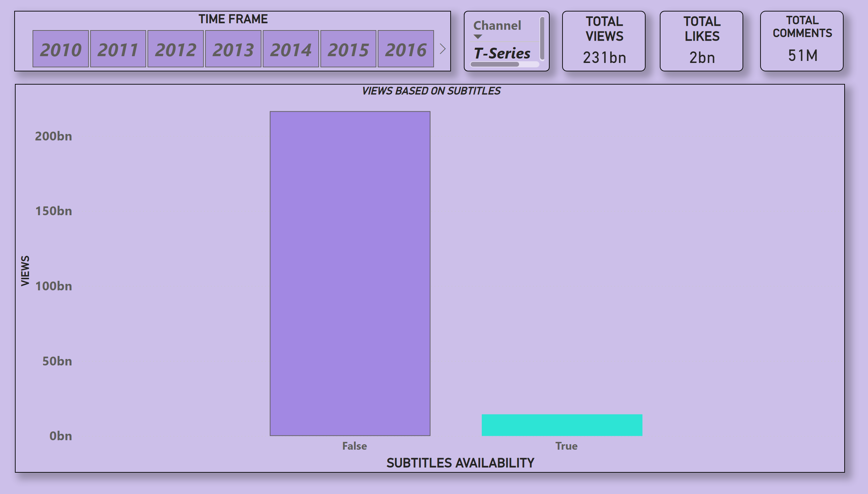
Page 4

Slide 6
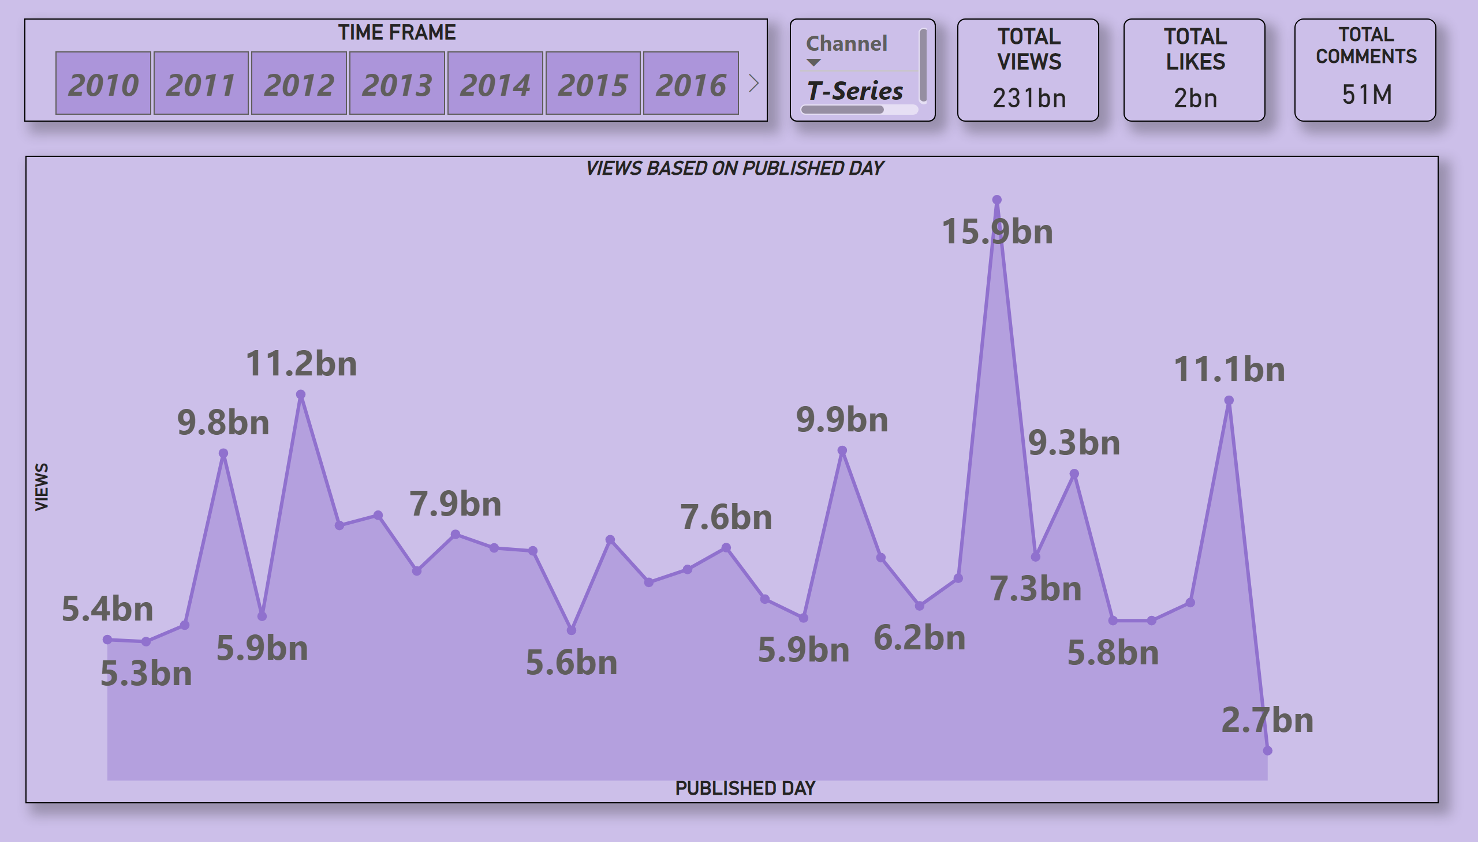
Page 5

Slide 7
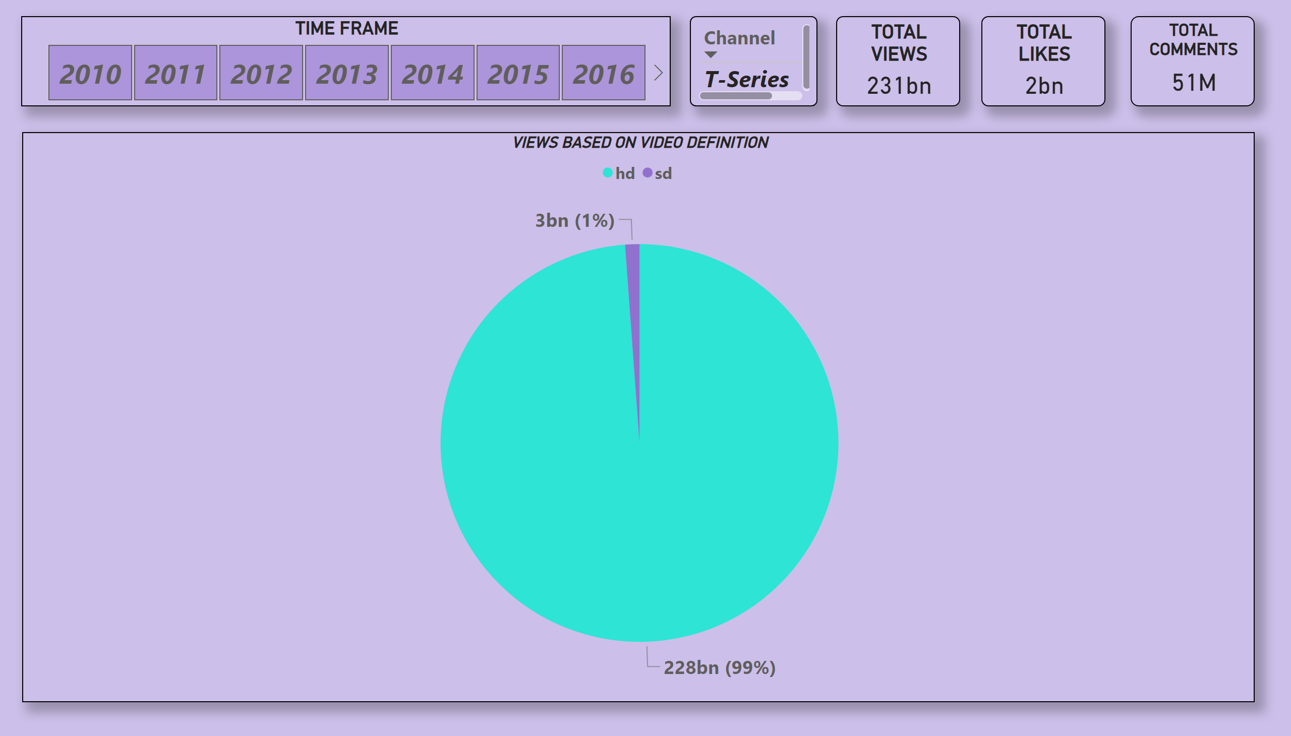
Page 6

Slide 8

THANK YOU!
Presented By: Shreyash Kumar
Batch: MIP-DA-10

